Slide 1


SeasonScope: A Comprehensive System for Season Recognition and Captioning for Season Images
By Haowen Xu
Jennifer Duan
Shiying Chen
TRANSCENDING DISCIPLINES, TRANSFORMING LIVES

Slide 2
Introduction
Identifying seasons images is changending due to varying geographic and temporal factors
SeasonScope aims to not only classify there images but also enrich them with descriptive captions
‹#› | SeasonScope
Notes:
‹#›

Slide 3
Dataset
Unsplash for 6000 images for each seasons
Use BLIP model to generate captions for season images
‹#› | SeasonScope
Notes:
‹#›

Slide 4
Method: Classification
Test pre-trained CNN model: Resnet, GoogleNet, EfficentNet
Designed custom CNN model
‹#› | SeasonScope
Notes:
‹#›

Slide 5
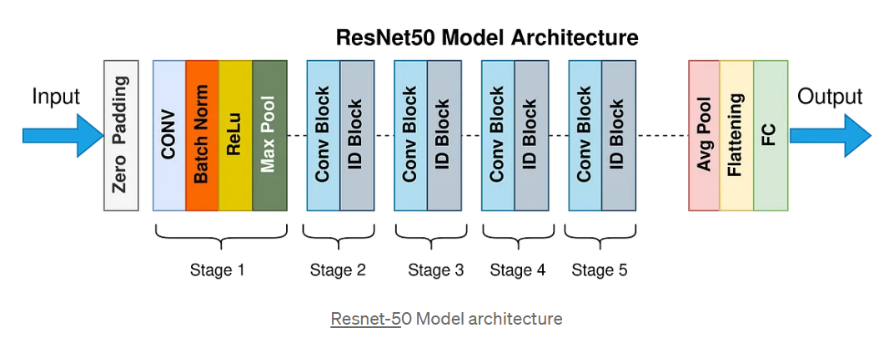
Method: Classification
ResNet

Slide 6
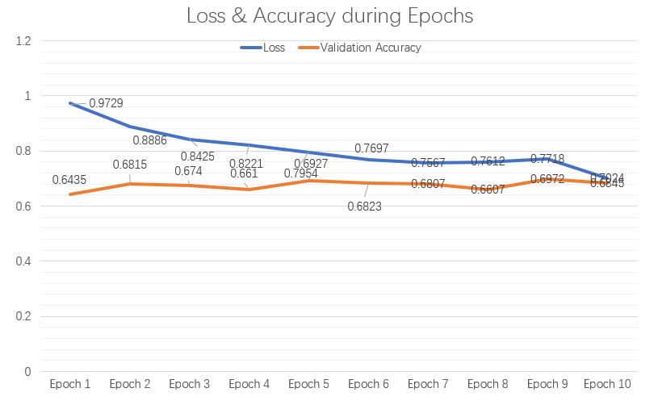
Method: Classification
ResNet Result
The training loss consistently decreases across 10 epochs, indicating learning progress, while the validation accuracy improves from 64.35% to a peak of 69.725%.
The training process seems to be on the right track, but there is still room for improvement, especially in achieving higher and more stable validation accuracy.

Slide 7
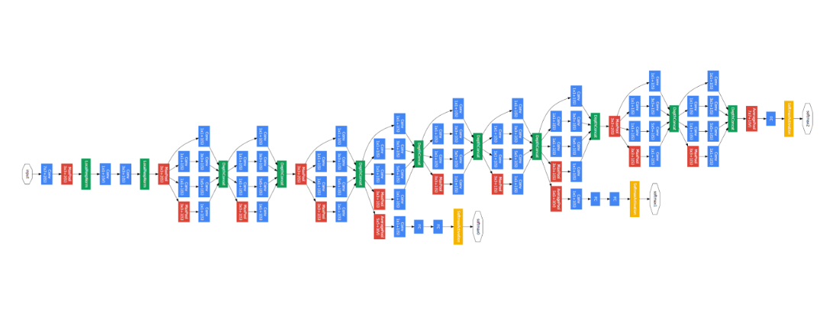
Method: Classification
GoogleNet

Slide 8
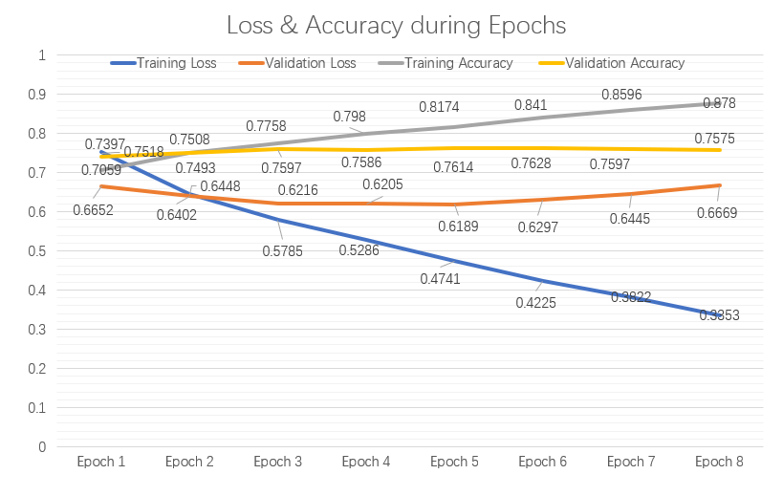
Method: Classification
GoogleNet Result
The GoogleNet model's performance improves steadily during training, with training and validation accuracies reaching up to 68.48% and 71.06%, respectively.
The model is performing well but appears to have hit a limit in its learning progress.

Slide 9
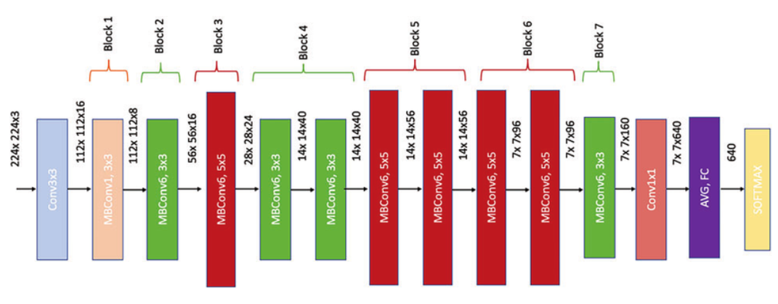
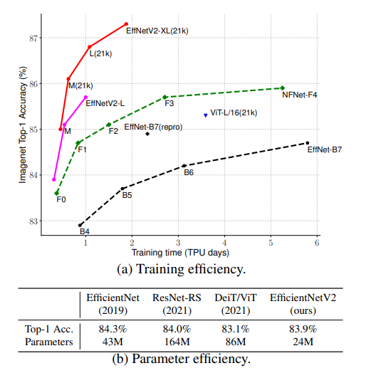
Method: Classification
Architecture: EfficentNet-V2
EfficientNet-V2 Architecture
Optimized Training: Designed with an improved training process, which makes it more efficient and faster to train than its predecessors.
Better Performance: Shown better performance on several benchmarks compared to its predecessors. It achieves this superior performance even though it requires less computational resources, making it a more efficient model.
‹#› | SeasonScope
Notes:
‹#›

Slide 10
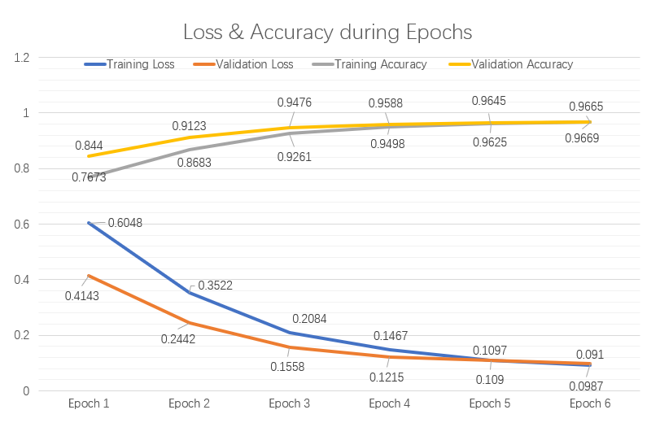
Method: Classification
EfficentNet Result:
The training results indicate that the EfficientNet-V2 model has performed well on the 4-season classification task.
The training and validation loss consistently decreased,
The training and validation accuracy improved steadily
The model was not only able to fit the training data well but also generalize to unseen validation data.
No apparent sign of overfitting or underfitting
The training process appears to be successful and stable, making the model a strong candidate for this classification task.
‹#› | SeasonScope
Notes:
‹#›

Slide 11
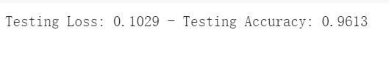
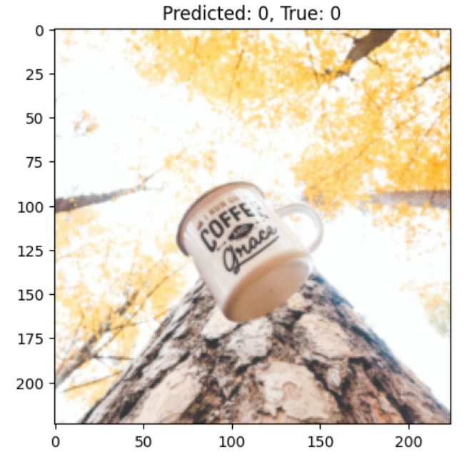
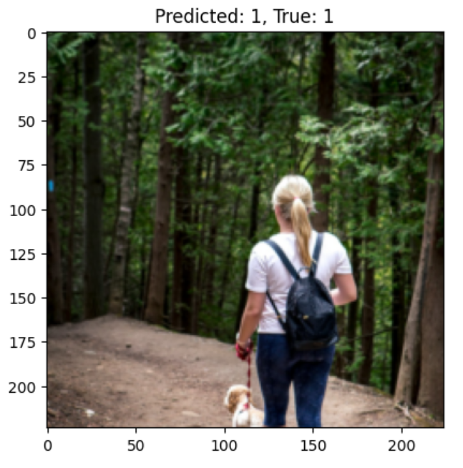
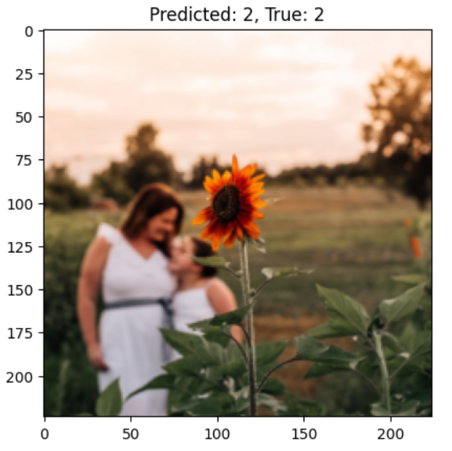
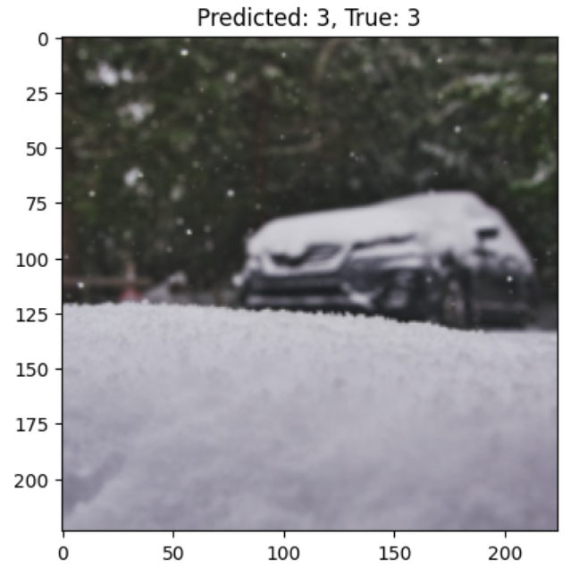
Result: Classification
Achieved over 96% accuracy on test dataset
Fall
Spring
Summer
Winter
‹#› | SeasonScope
Notes:
‹#›

Slide 12
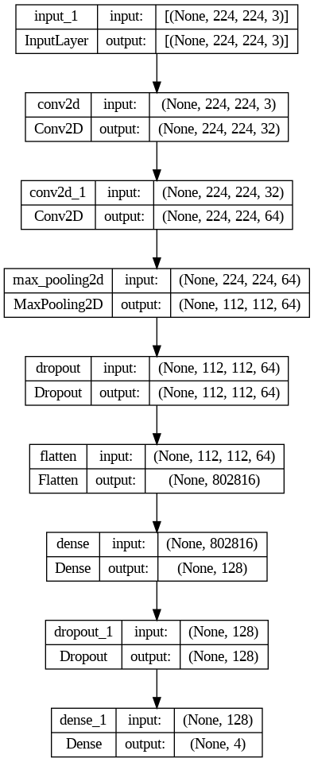
Method: Classification
Designed custom CNN model
A simple CNN that takes in 3-channel images. It consists of:
Two convolutional layers
After each convolution, ReLU activation is applied.
A max-pooling layer with a 2x2 window to reduce spatial dimensions by half.
Dropout is applied after each convolutional layer (25% after the first and 50% after the second) to prevent overfitting.
The flattened output of the convolutional layers feeds into two fully connected layers
A log softmax function
‹#› | SeasonScope
Notes:
‹#›

Slide 13
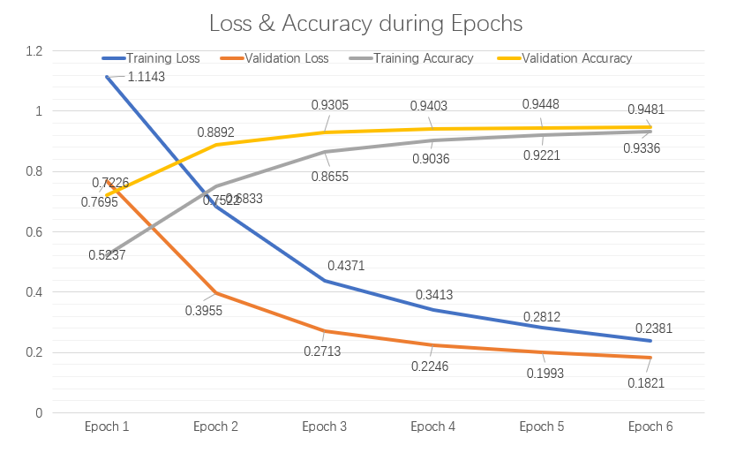
Method: Classification
Custom CNN Model Result

Slide 14
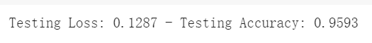
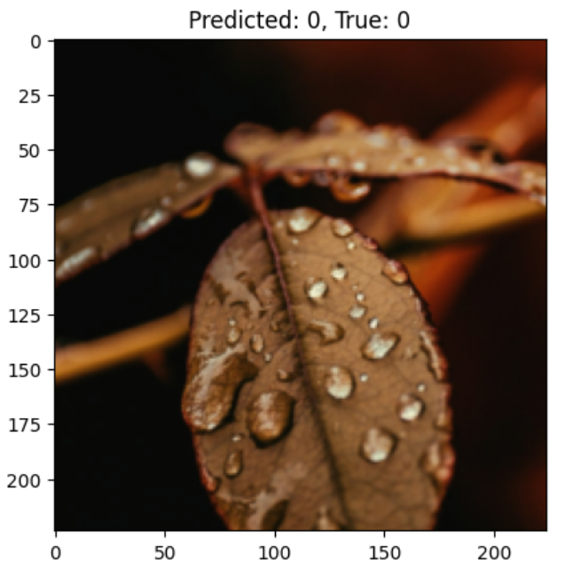
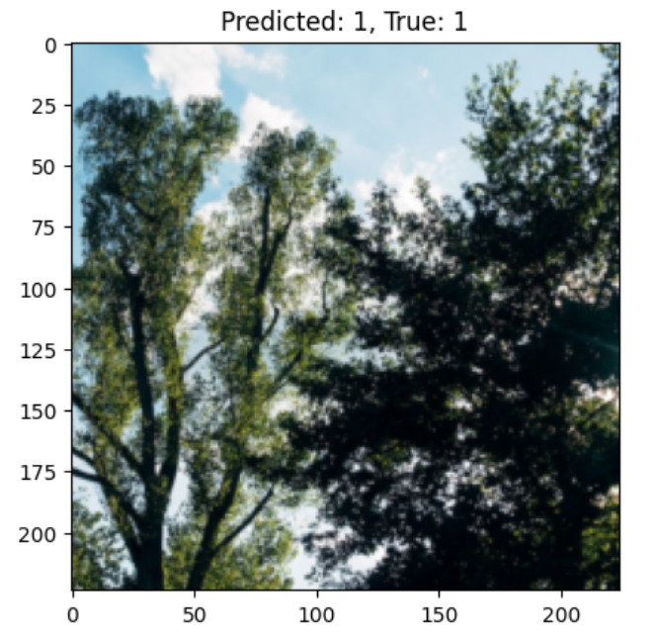
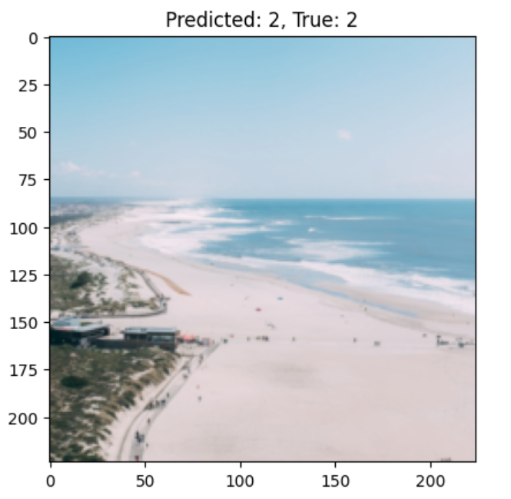
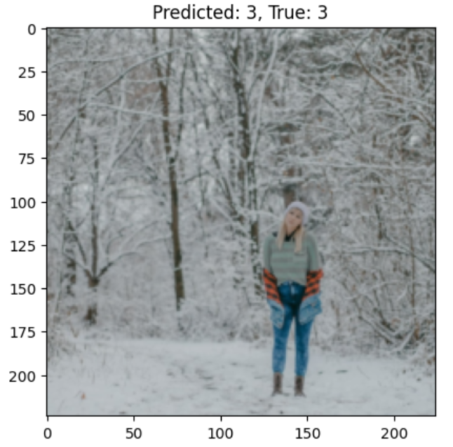
Result: Classification
Achieved over 95% accuracy on test dataset
Fall
Spring
Summer
Winter
‹#› | SeasonScope
Notes:
‹#›

Slide 15
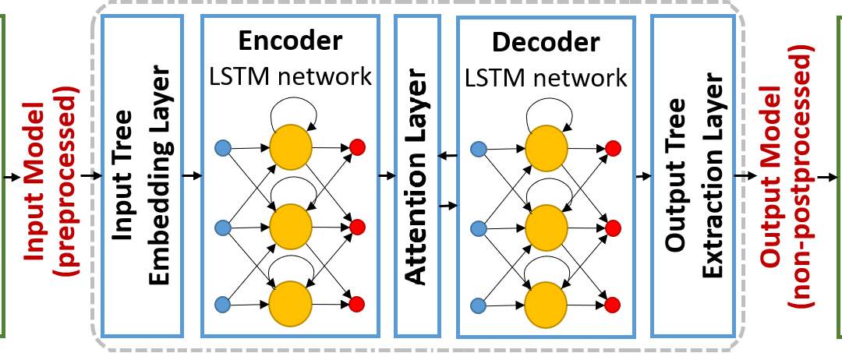
Method: Image Captioning
Use CNN model for feature extraction: Inception V3
Use LSTM for caption generation
‹#› | SeasonScope
Notes:
‹#›

Slide 16
Training Process
Use CNN model for feature extraction
Use LSTM for caption generation
‹#› | SeasonScope
Notes:
‹#›

Slide 17
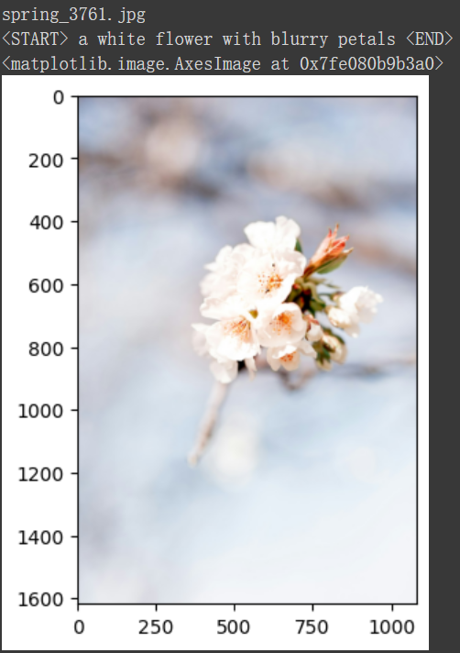
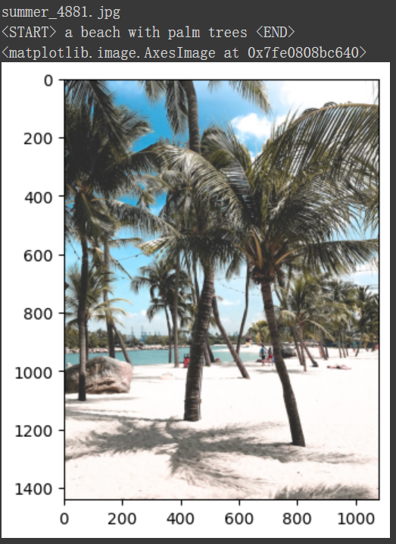
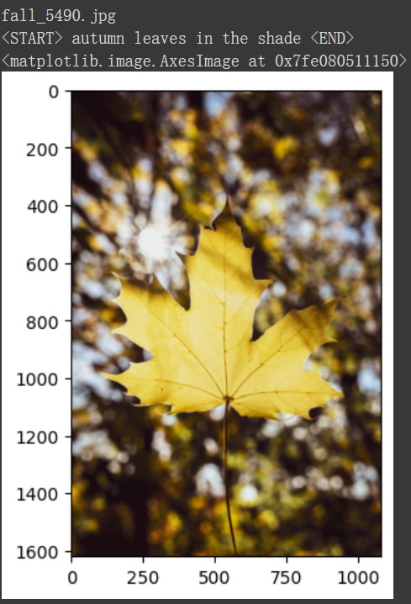
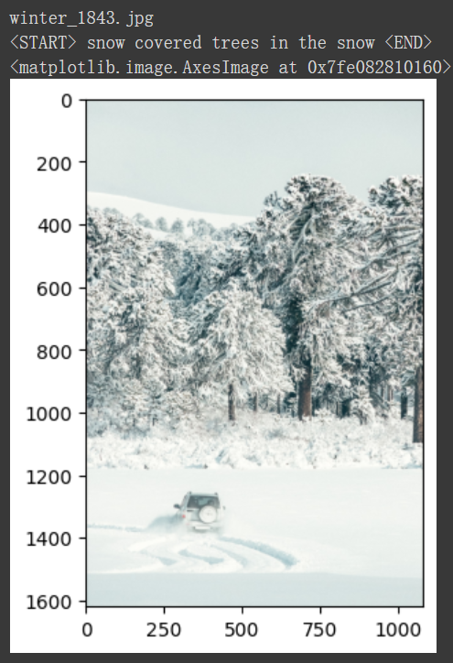
Result: Image Captioning
Captions generated are highly relevant
‹#› | SeasonScope
Notes:
‹#›

Slide 18
Discussion
Gather more data to improve
Combine classification with image captioning
‹#› | SeasonScope
Notes:
‹#›

Slide 19
Conclusion
We are able to achieve high accuracy on both classification and image captioning
‹#› | SeasonScope
Notes:
‹#›

Slide 20
Q&A
‹#› | SeasonScope
Notes:
‹#›

Slide 21

Thank you for your listening!
We are now open to questions from the audience.
‹#› | SeasonScope
Notes:
‹#›

